Slide 1
Chapter 3:
Expressions and the Interactivity
Brief Version of Starting Out with C++, 5/e
by Tony Gaddis and Barret Krupnow

Slide 2
3.1
The cin Object

Slide 3
The cin Object
Standard input object
Like cout, requires iostream file
Used to read input from keyboard
Information retrieved from cin with >>
Input is stored in one or more variables

Slide 4
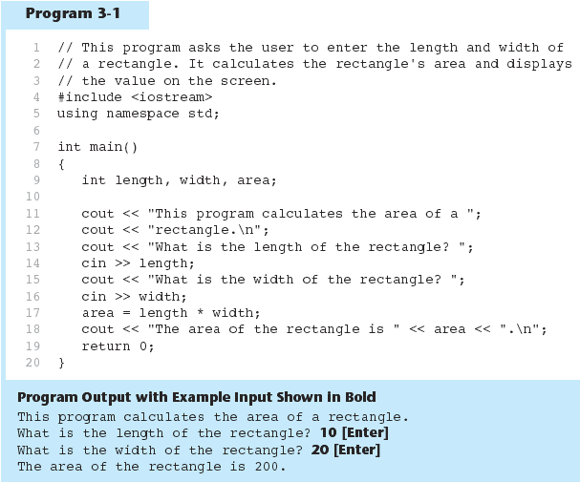

Slide 5
The cin Object
cin converts data to the type that matches the variable:
  int height;
  cout << "How tall is the room? ";
  cin >> height;

Slide 6
Displaying a Prompt
A prompt is a message that instructs the user to enter data.
You should always use cout to display a prompt before each cin statement.
cout << "How tall is the room? ";
cin >> height;

Slide 7
The cin Object
Can be used to input more than one value:
  cin >> height >> width;
Multiple values from keyboard must be separated by spaces
Order is important: first value entered goes to first variable, etc.

Slide 8
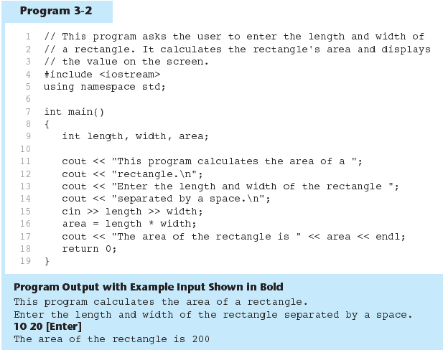

Slide 9
Reading Strings with cin
Can be used to read in a string
Must first declare an array to hold characters in string:
  char myName[21];
nyName is name of array, 21 is the number of characters that can be stored (the size of the array), including the NULL character at the end
Can be used with cin to assign a value:
  cin >> myName;

Slide 10
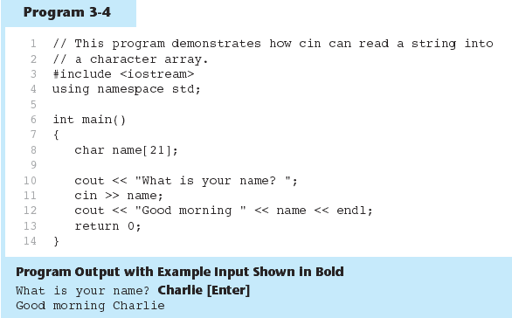

Slide 11
3.2
Mathematical Expressions

Slide 12
Mathematical Expressions
Can create complex expressions using multiple mathematical operators
An expression can be a literal, a variable, or a mathematical combination of constants and variables
Can be used in assignment, cout, other statements:
  area = 2 * PI * radius;
  cout << "border is: " << 2*(l+w);

Slide 13
Order of Operations
In an expression with more than one operator, evaluate in this order:
  - (unary negation), in order, left to right
  * / %, in order, left to right
  + -, in order, left to right
In the expression 2 + 2 * 2 – 2
evaluate
first
evaluate
third
evaluate
second

Slide 14
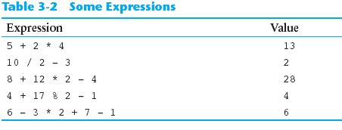
Order of Operations

Slide 15
Associativity of Operators
- (unary negation) associates right to left
*, /, %, +, - associate right to left
parentheses ( ) can be used to override the order of operations:
  2 + 2 * 2 – 2 = 4
  (2 + 2) * 2 – 2 = 6
  2 + 2 * (2 – 2) = 2
  (2 + 2) * (2 – 2) = 0

Slide 16
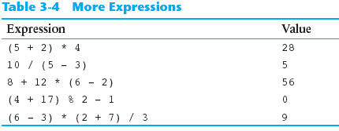
Grouping with Parentheses

Slide 17
Algebraic Expressions
Multiplication requires an operator:
  Area=lw is written as Area = l * w;
There is no exponentiation operator:
  Area=s² is written as Area = pow(s, 2);
Parentheses may be needed to maintain order of operations:
  is written as
  m = (y2-y1) /(x2-x1);

Slide 18
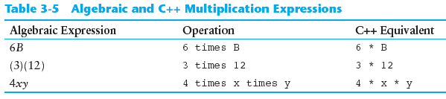
Algebraic Expressions

Slide 19
3.3
When You Mix Apples and Oranges: Type Conversion

Slide 20
When You Mix Apples and Oranges: Type Conversion
Operations are performed between operands of the same type.
If not of the same type, C++ will convert one to be the type of the other
This can impact the results of calculations.

Slide 21
Hierarchy of Types
Highest:
Lowest:
Ranked by largest number they can hold
long double
double
float
unsigned long
long
unsigned int
int

Slide 22
Type Coercion
Type Coercion: automatic conversion of an operand to another data type
Promotion: convert to a higher type
Demotion: convert to a lower type

Slide 23
Coercion Rules
1) char, short, unsigned short automatically promoted to int
2) When operating on values of different data types, the lower one is promoted to the type of the higher one.
3) When using the = operator, the type of expression on right will be converted to type of variable on left

Slide 24
3.4
Overflow and Underflow

Slide 25
Overflow and Underflow
Occurs when assigning a value that is too large (overflow) or too small (underflow) to be held in a variable
Variable contains value that is ‘wrapped around’ set of possible values
Different systems may display a warning/error message, stop the program, or continue execution using the incorrect value

Slide 26
3.5
Type Casting

Slide 27
Type Casting
Used for manual data type conversion
Useful for floating point division using ints: double m;
m = static_cast<double>(y2-y1)
/(x2-x1);
Useful to see int value of a char variable:
char ch = 'C';
cout << ch << " is "
<< static_cast<int>(ch);

Slide 28
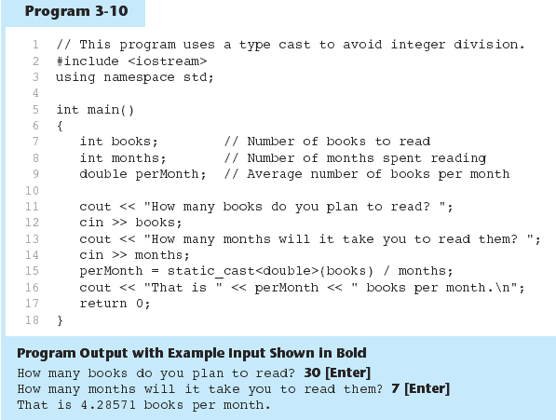

Slide 29
C-Style and Prestandard Type Cast Expressions
C-Style cast: data type name in ()
cout << ch << " is " << (int)ch;
Prestandard C++ cast: value in ()
cout << ch << " is " << int(ch);
Both are still supported in C++, although static_cast is preferred

Slide 30
3.6
Named Constants

Slide 31
Named Constants
Named constant (constant variable): variable whose content cannot be changed during program execution
Used for representing constant values with descriptive names:
  const double TAX_RATE = 0.0675;
  const int NUM_STATES = 50;
Often named in uppercase letters

Slide 32
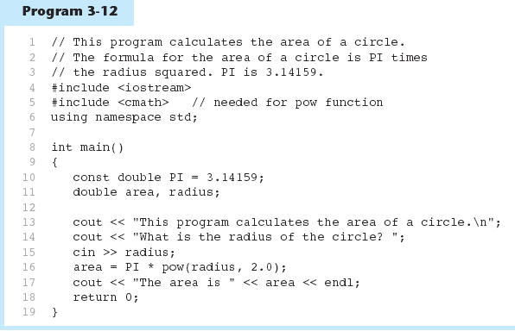

Slide 33
Constants and Array Sizes
It is a common practice to use a named constant to indicate the size of an array:
const int SIZE = 21;
char name[SIZE];

Slide 34
const vs. #define
#define – C-style of naming constants:
  #define NUM_STATES 50
  Note no ; at end
Interpreted by pre-processor rather than compiler
Does not occupy memory location like const

Slide 35
3.7
Multiple Assignment and
Combined Assignment

Slide 36
Multiple Assignment and Combined Assignment
The = can be used to assign a value to multiple variables:
  x = y = z = 5;
Value of = is the value that is assigned
Associates right to left:
  x = (y = (z = 5));
value
is 5
value
is 5
value
is 5

Slide 37
Combined Assignment
Look at the following statement:
  sum = sum + 1;
  This adds 1 to the variable sum.

Slide 38
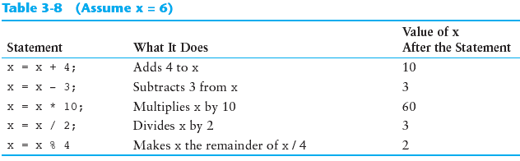
Other Similar Statements

Slide 39
Combined Assignment
The combined assignment operators provide a shorthand for these types of statements.
The statement
  sum = sum + 1;
  is equivalent to
  sum += 1;

Slide 40
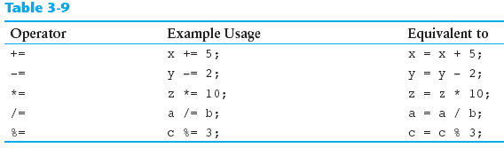
Combined Assignment Operators

Slide 41
3.8
Formatting Output

Slide 42
Formatting Output
Can control how output displays for numeric, string data:
  size
  position
  number of digits
Requires iomanip header file

Slide 43
Stream Manipulators
Used to control how an output field is displayed
Some affect just the next value displayed:
  setw(x): print in a field at least x spaces wide. Use more spaces if field is not wide enough

Slide 44
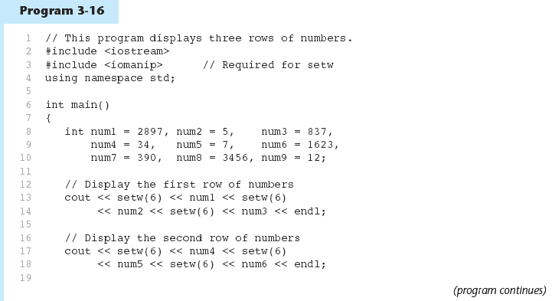

Slide 45
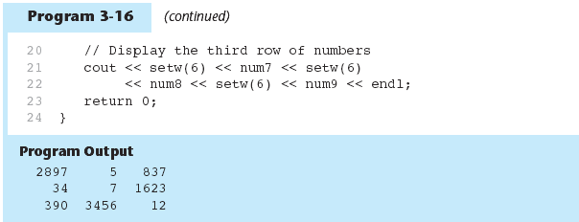

Slide 46
Stream Manipulators
Some affect values until changed again:
  fixed: use decimal notation for floating-point values
  setprecision(x): when used with fixed, print floating-point value using x digits after the decimal. Without fixed, print floating-point value using x significant digits
  showpoint: always print decimal for floating-point values

Slide 47
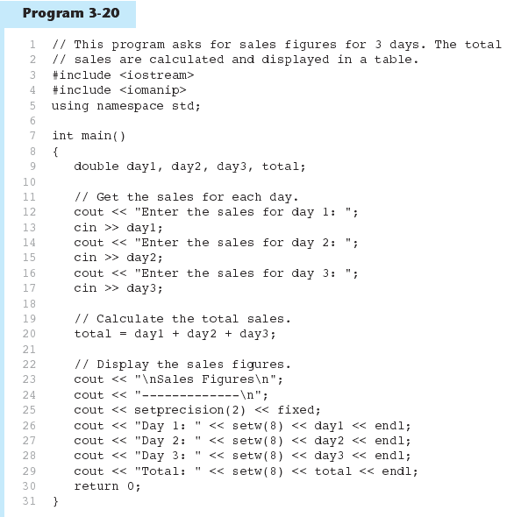

Slide 48
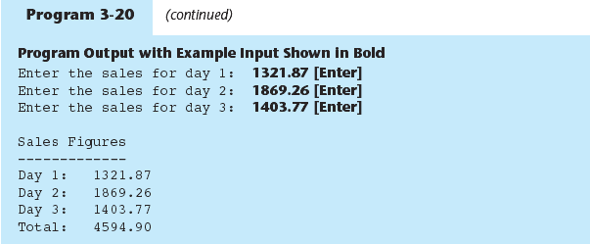

Slide 49
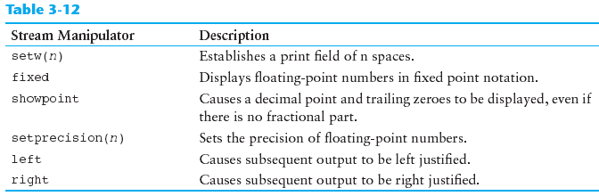
Stream Manipulators

Slide 50
3.9
Formatted Input

Slide 51
Formatted Input
Can format field width for use with cin
Useful when reading string data to be stored in a character array:
const int SIZE = 10;
  char firstName[SIZE];
  cout << "Enter your name: ";
  cin >> setw(SIZE) >> firstName;
cin reads one less character than specified with the setw() manipulator

Slide 52
Formatted Input
To read an entire line of input, use cin.getline():
  const int SIZE = 81;
  char address[SIZE];
  cout << "Enter your address: ";
  cin.getline(address, SIZE);
cin.getline takes two arguments:
  Name of array to store string
  Size of the array

Slide 53
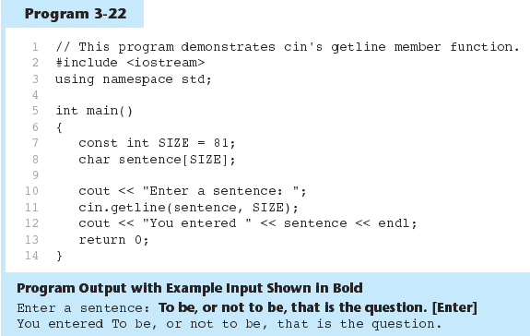

Slide 54
Formatted Input
To read a single character:
  Use cin:
    char ch;
    cout << "Strike any key to continue";
    cin >> ch;
    Problem: will skip over blanks, tabs, <CR>
  Use cin.get():
    cin.get(ch);
    Will read the next character entered, even whitespace

Slide 55
Formatted Input
Mixing cin >> and cin.get() in the same program can cause input errors that are hard to detect
To skip over unneeded characters that are still in the keyboard buffer, use cin.ignore():
  cin.ignore(); // skip next char
  cin.ignore(10, '\n'); // skip the next
  // 10 char. or until a '\n'

Slide 56
3.10
More About Member Functions

Slide 57
More About Member Functions
Member Function: procedure that is part of an object
cout, cin are objects
Some member functions of the cin object:
  getline
  get
  ignore

Slide 58
3.11
More Mathematical Library Functions

Slide 59
More Mathematical Library Functions
Require cmath header file
Take double as input, return a double
Commonly used functions:
sin | Sine
cos | Cosine
tan | Tangent
sqrt | Square root
log | Natural (e) log
abs | Absolute value (takes and returns an int)

Slide 60
More Mathematical Library Functions
These require cstdlib header file
rand(): returns a random number (int) between 0 and the largest int the compute holds. Yields same sequence of numbers each time program is run.
srand(x): initializes random number generator with unsigned int x

Slide 61
3.12
Hand Tracing a Program

Slide 62
Hand Tracing a Program
Hand trace a program: act as if you are the computer, executing a program:
  step through and ‘execute’ each statement, one-by-one
  record the contents of variables after statement execution, using a hand trace chart (table)
Useful to locate logic or mathematical errors

Slide 63
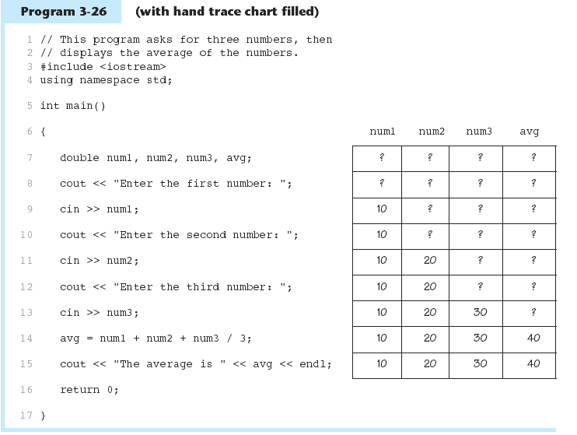

Slide 64
3.14
Introduction to File Input and Output

Slide 65
Introduction to File Input and Output
Can use files instead of keyboard, monitor screen for program input, output
Allows data to be retained between program runs
Steps:
  Open the file
  Use the file (read from, write to, or both)
  Close the file

Slide 66
Files: What is Needed
Use fstream header file for file access
File stream types:
  ifstream for input from a file
  ofstream for output to a file
  fstream for input from or output to a file
Define file stream objects:
  ifstream infile;
  ofstream outfile;

Slide 67
Opening Files
Create a link between file name (outside the program) and file stream object (inside the program)
Use the open member function:
  infile.open("inventory.dat");
  outfile.open("report.txt");
Filename may include drive, path info.
Output file will be created if necessary; existing file will be erased first
Input file must exist for open to work

Slide 68
Using Files
Can use output file object and << to send data to a file:
  outfile << "Inventory report";
Can use input file object and >> to copy data from file to variables:
  infile >> partNum;
  infile >> qtyInStock >> qtyOnOrder;

Slide 69
Closing Files
Use the close member function:
  infile.close();
  outfile.close();
Don’t wait for operating system to close files at program end:
  may be limit on number of open files
  may be buffered output data waiting to send to file

Slide 70
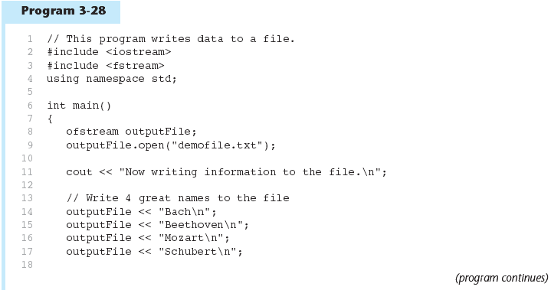

Slide 71
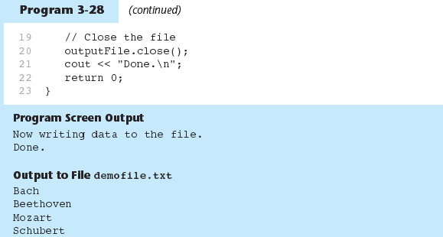

Slide 72
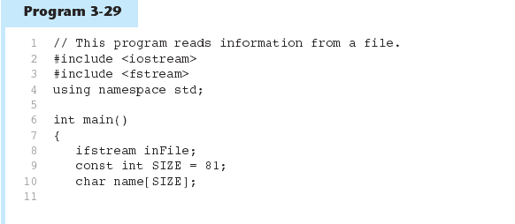
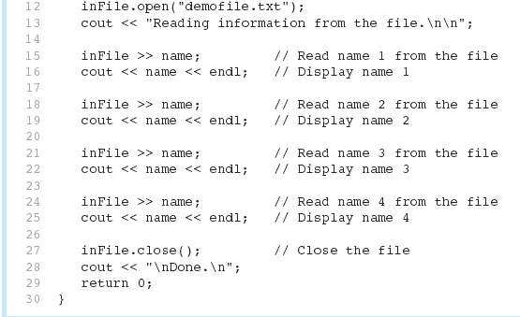

Slide 73
